Slide 1
Merging two repositories with git
Ryan Burnett, Infosys Associate

Slide 2
To start
This document serves as a guide for merging two previously unrelated git repositories. This can be more complex than merging branches in a single repository, but can be done with a similar git workflow.
For this guide, I will be merging the repo named “test1” into the repo named “test2”.
Repo “test1” will remain unchanged.

Slide 3


Slide 4
First, in a bash terminal, navigate to the repo you wish to merge into (in this case, “test2”). Once in this directory, execute the command:

Slide 5
git remote add <repo to be merged> <remote path>

Slide 6
This will stage “test1” to be added to “test2”
Next, execute the command:

Slide 7
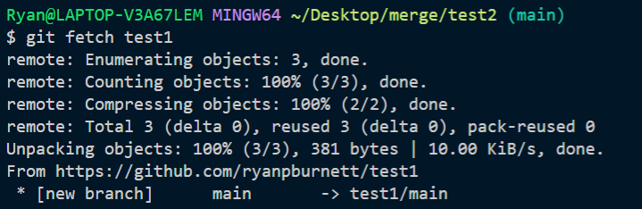
git fetch <repo to be merged>
If successful, this message will display:

Slide 8
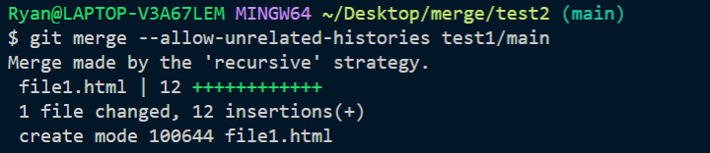
To complete the merge, execute this command:
git merge -–allow-unrelated-histories <repo to be merged>/<branch>

Slide 9

Afterwards, the repos will look like this, in this example:

Slide 10
The --allow unrelated-histories flag is important, since otherwise git will have difficulty managing history conflicts. If this flag is not present, this error will occur:

Slide 11


Slide 12
Committing changes
After this, a normal commit can be made as usual, from the same directory:

Slide 13
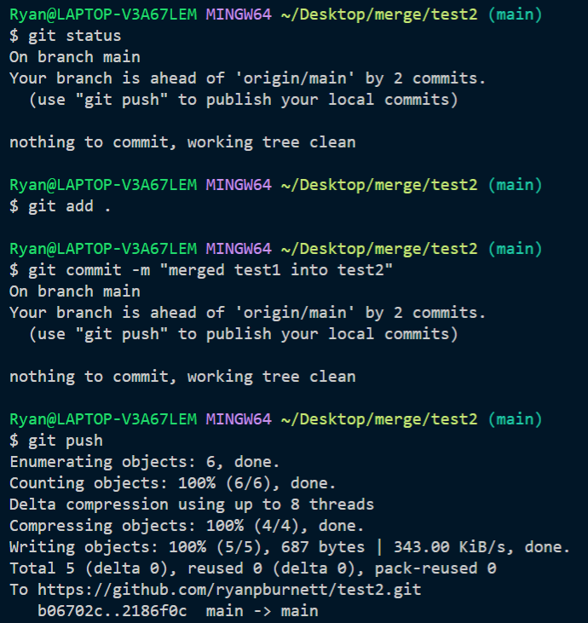

Slide 14
After this, all files from both repos should be successfully merged.

Slide 15
Adding new changes
In the event that more changes happen in the first repo, that need to be reflected in the second (joined) repo, the following commands can be executed:

Slide 16
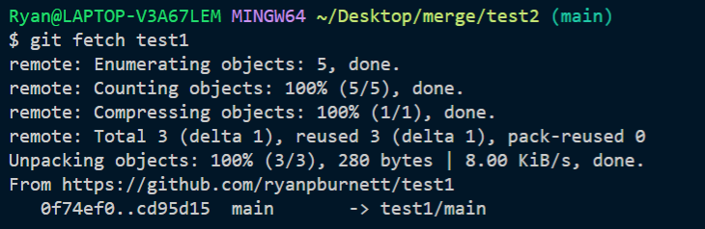
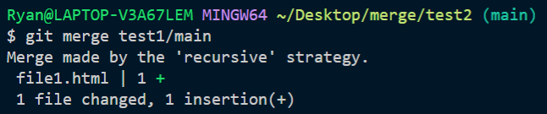
git fetch <first repo> git merge <first repo>/<branch>

Slide 17
After this, the usual commit workflow described above will commit these changes remotely.

